Slide 1
MAOC
Motion Axis Output Cam Instruction
Name – Steven Sitko
Title – Motion Support Engineer
Date – 2/01/2018

Slide 2
MAOC Overview: Output Cam
What does an MAOC do?
MAOC allows you to turn on and off outputs based on the position of an Axis.
Applications
  Gluing machines
  Machines using imaging for quality assurance
  Punches and Presses

Slide 3
MAOC Overview: Control Bits
The Control bits of the MAOC
Enable (EN)
  Rung goes true
Done (DN)
  If the instruction issues successfully
Error (ER)
  If the instruction fails to issue
In Process (IP)
  On while the instruction is running.
Process Complete (PC)
  If the instruction was able to complete without being stopped

Slide 4
MAOC Overview: The Instruction Layout
The Parameters of the MAOC
Execution Target
  The execution target defines the specific Output Cam from the set connected to the named axis.
Set in the axis properties
  Must be set to at least a value of 1 to use an MAOC

Slide 5
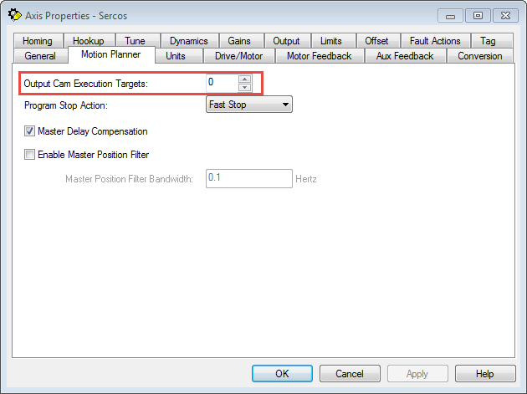
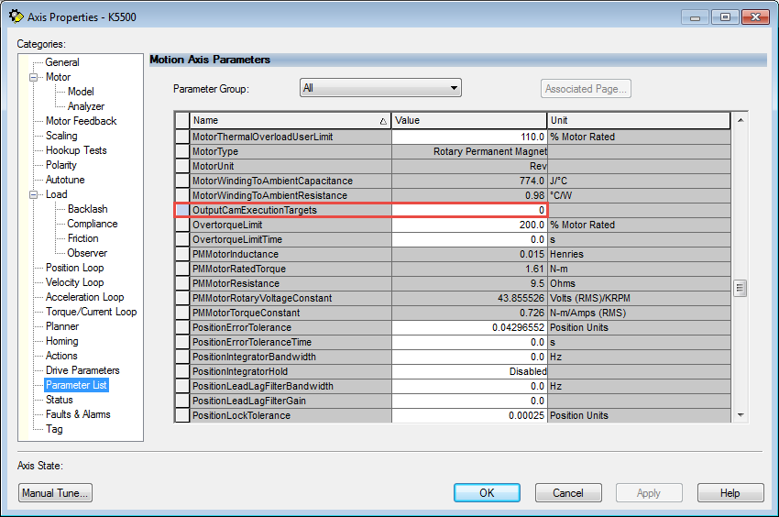
MAOC Overview: The Instruction Layout
Setting the Number of Execution Targets

Slide 6
MAOC Overview: The Instruction Layout
The Parameters of the MAOC
Motion Control Tag must be unique
  Contains the control bits
Output
  Can be an output card or a Tag
Input
  Can be an input card or a Tag
  Can be used as a condition for the output

Slide 7
MAOC Overview: Cam Editor
Create the Cam Profile
Output Cam Tag is an array
  Array size must be big enough for each segment in the cam profile
  Recommended to be the same size as the number of segments
Positions are incremental Not Absolute

Slide 8
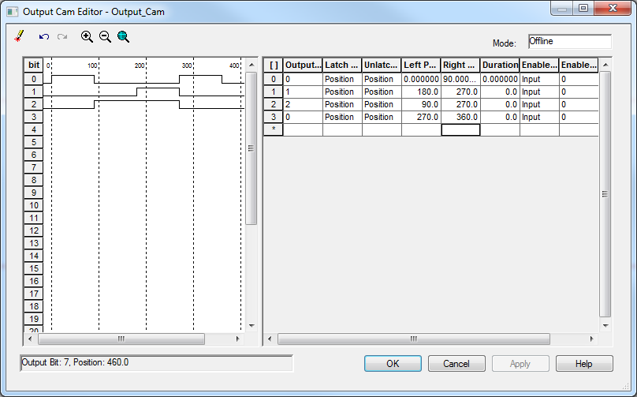
MAOC Overview: Cam Editor

Slide 9
MAOC Overview: Latch Types

Slide 10
MAOC Overview: Unlatch Types

Slide 11
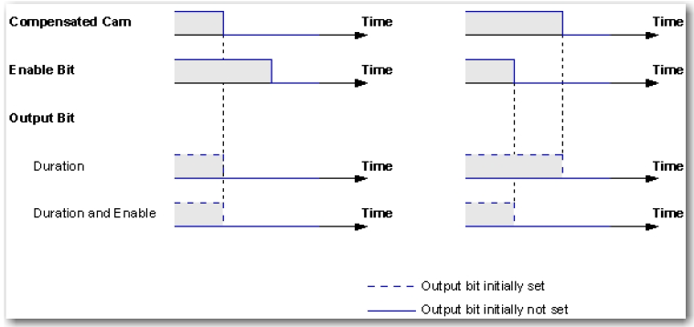
MAOC Overview: Unlatch Types
Duration
Notes:
Duration is in Seconds

Slide 12
MAOC Overview: The Instruction Layout
Output Cam Range
Cam Start and End Positions
  Define the left and right boundaries of the Output Cam range.
  This is the distance of the cam profile

Slide 13
MAOC Overview: The Instruction Layout
Output Compensation
Output Compensation
  A tag array where the indices correspond to the output bit numbers.
  Output compensation enables the motion planner to account for the delay in opening and closing valves, relays, or other delays inherent to the application
  Changes are applied immediately

Slide 14
MAOC Overview: The Instruction Layout
Output Compensation
Offset
  Provides position compensation
Latch and Unlatch Delay
  Provides time delay compensation
  Values are in seconds
Latch Offset = v * Latch Delay
Unlatch Offset = v * Unlatch Delay

Slide 15
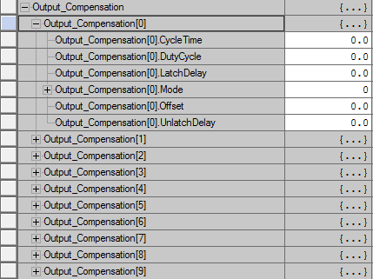
MAOC Overview: The Instruction Layout
Output Compensation
Mode
  Allows you to change how the output responds to the cam
  Inverted flips the conditions
  Pulsed has the output pulse instead of hold
Duty Cycle and Cycle Time
  Are used for Pulsed mode

Slide 16
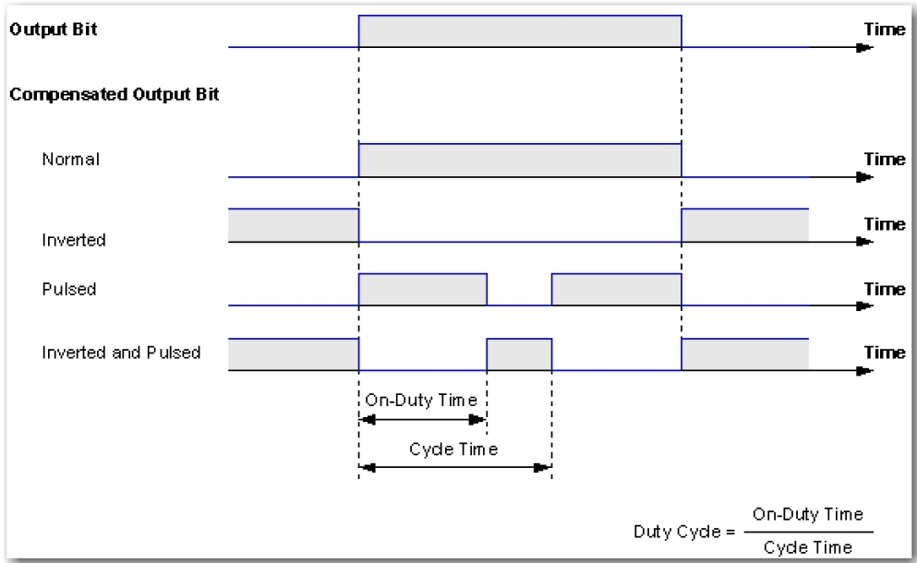
MAOC Overview: The Instruction Layout
Output Compensation

Slide 17
MAOC Overview: The Instruction Layout
Execution Mode
Once – Output Cam is disarmed and the PC bit is set when the cam position moves beyond the cam start or the cam end position.
Continuous – Output Cam continues on the opposite side of the Output Cam range when the cam position moves beyond the cam start or the cam end position.
Persistent – Output Cam disarms when the cam position moves beyond the cam start or the cam end position. The Cam is rearmed when the cam position moves back into the range.

Slide 18
MAOC Overview: The Instruction Layout
Execution Schedule
Immediate – Output Cam is armed at once.
Pending – Output cam is armed when the cam position of a currently executing Output Cam moves beyond its cam start or cam end position.
Forward only, Reverse only, and Bidirectional – Output Cam is armed when the axis approaches or passes through the specified axis arm position in selected direction.

Slide 19
MAOC Overview: The Instruction Layout
The Parameters of the MAOC
Axis Arm Position
  If set for an Execution Schedule based on position, sets what position the cam will lock and become active
Cam Arm Position
  Determines where in the cam profile the cam will start

Slide 20
MAOC Overview: The Instruction Layout
The Parameters of the MAOC
Position Reference
  Determines whether the outputs trigger off the command position or the actual position of the axis

Slide 21
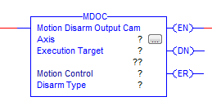
MDOC: Stopping an MAOC
The Parameters of the MDOC
Disarm Type
  All – Disarms all output cams on the selected axis
  Specific – Disarms the output cam associated with to the execution target
MDOC does not turn off the outputs. It ends the MAOC’s control over the outputs

Slide 22
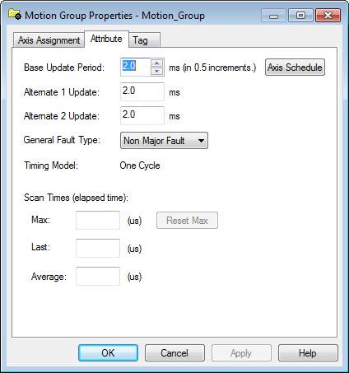
MAOC Overview: Scheduling
Scheduling
For non-scheduled output cards, the schedule interval is equal to the motion group course update rate
For scheduled output cards, it depends on the update rate of the output card
Schedule interval must meet the minimum distance between on/off conditions

Slide 23
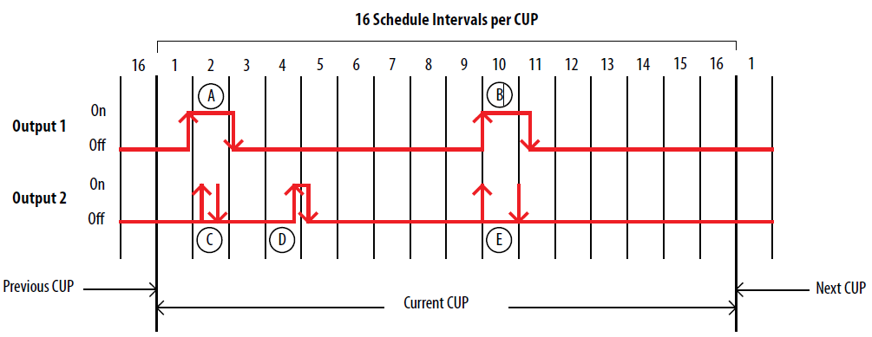
MAOC Overview: Scheduling
Scheduled Output Timing 1756-OB16IEFS

Slide 24
Reference Materials
Manuals
Motion Instruction Manual: Publication: MOTION-RM002
Position-based Output Control: Publication:1756-AT017
Knowledgebase
MAOC Latch and Unlatch Type of Position and Enable: 57446
Understanding MAOC Latch Delay Compensation: 57449

Slide 25
Thank You

